Slide 1
Science Gateways
Sandra Gesing
August 17, 2023

Slide 2
Research Computing
Increased complexity of
Today’s research questions
Data
Hardware and software
Skills required
Greater need for openness and reproducibility
Driving policy questions
Interdisciplinary distributed projects
Opportunity to integrate research with teaching
Better workforce preparation
We need end-to-end solutions that provide
broad access to advanced resources and allow
all to tackle
today’s challenging science questions
➔ Science Gateways

Slide 3
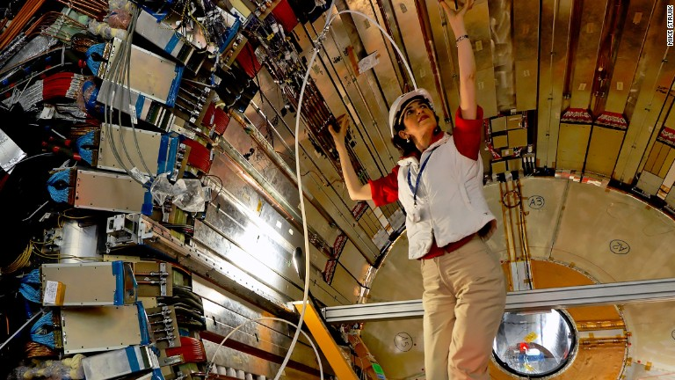

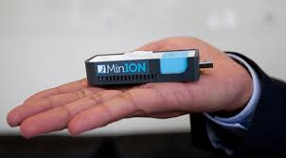




Research Computing
Lab Instruments
Web-based
agile frameworks
Distributed data and
computing infrastructures
Data and Compute-intensive
Problems
High-speed networks
Research Software

Slide 4
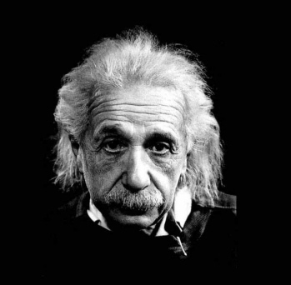
Lab Instruments
Web-based
agile frameworks
Research Computing
Distributed data and
computing infrastructures
Data and Compute-intensive
Problems
High-speed networks
Research Software

Slide 5
Research Computing
Lab Instruments
Web-based
agile frameworks
Distributed data and
computing infrastructures
Data and Compute-intensive
Problems
Need for science gateways
High-speed networks
Research Software

Slide 6

Research Computing
Lab Instruments
Web-based
agile frameworks
Distributed data and
computing infrastructures
Data and Compute-intensive
Problems
High-speed networks
Research Software

Slide 7
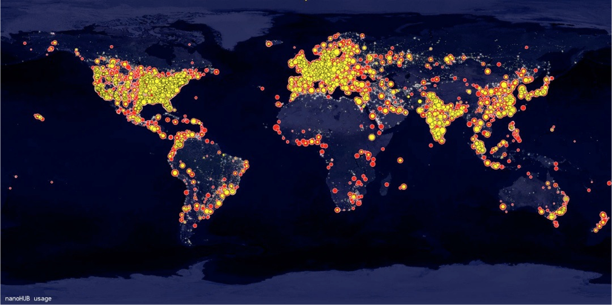
Science Gateway Technologies
Widely used complete frameworks (HUBzero, Galaxy, Globus Data Portal, etc.)
RESTful APIs and support of multiple programming languages in widely used frameworks (Apache Airavata, TAPIS, etc.)
Reused interface implementations (CIPRES, etc.)
Science gateways as a service with provision of hardware in the background (SciGap, etc.)
Lessons learned:
Approaches should be technology agnostic, using APIs and standard web technologies OR deliver a complete solution
Community Engagement is key
HUBzero users world wide

Slide 8

Science Gateways – Involved Concepts
Usability
Reproducibility and Re-usability
Interoperability
Sustainability

Slide 9

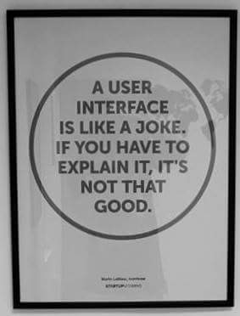
Usability
“After all, usability really just means that making sure that something works well: that a person … can use the thing - whether it's a Web site, a fighter jet, or a revolving door - for its intended purpose without getting hopelessly frustrated.”
Steve Krug in “Don't make me think!:
A Common Sense Approach to Web Usability”, 2005

Slide 10
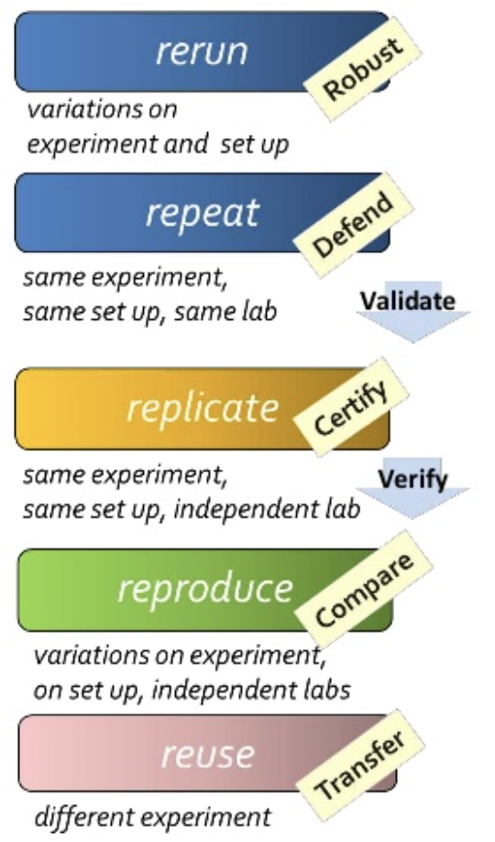
Reproducibility Replicability
Re-usability
“Reproducibility means obtaining consistent computational results using the same input data, computational steps, methods, code, and conditions of analysis. Replicability means obtaining consistent results across studies aimed at answering the same scientific question, each of which has obtained its own data.”
“The key to productivity is reusability.
The easiest way to
produce code is obviously to
have it already!"
John R. Bourne in “Object-oriented Engineering: Building Engineering Systems Using Smalltalk-80”, 1992
https://www.slideshare.net/carolegoble/what-is-reproducibility-gobleclean
https://phys.org/news/2019-05-replicability-science.html

Slide 11
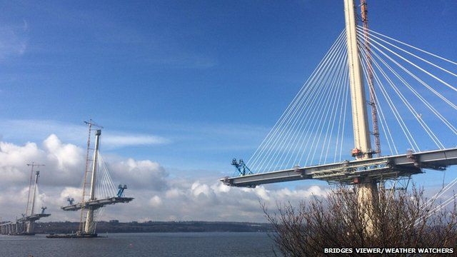
Interoperability
“capability to communicate, execute programs, or transfer data among various functional units in a manner that requires the user to have little or no knowledge of the unique characteristics of those units”
ISO/EIC 2382 Information Technology Vocabulary
“the ability of two or more systems or components to exchange information and to use the information that has been exchanged”
IEEE Standard Computer Dictionary: A Compilation of IEEE Standard Computer Glossaries

Slide 12

Sustainability
Sustainability means that the software you use today will be available - and continue to be improved and supported –
in the future.
Software Sustainability Institute

Slide 13
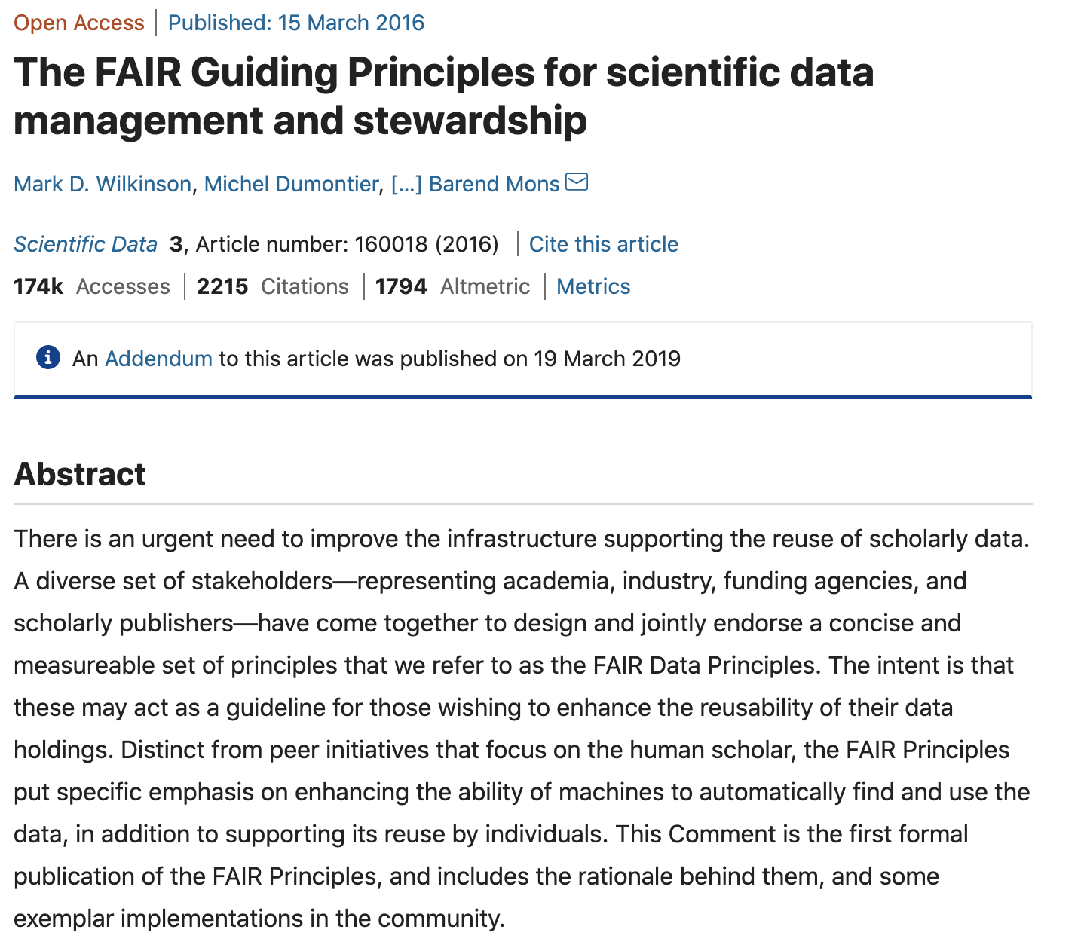
FAIR
Findable
Accessible
Interoperable
Reusable

Slide 14
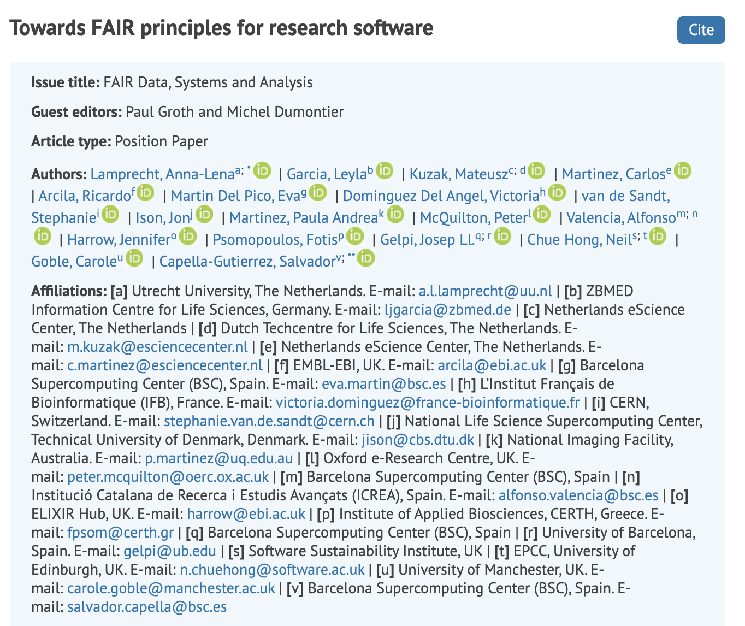
FAIR for Research Software

Slide 15
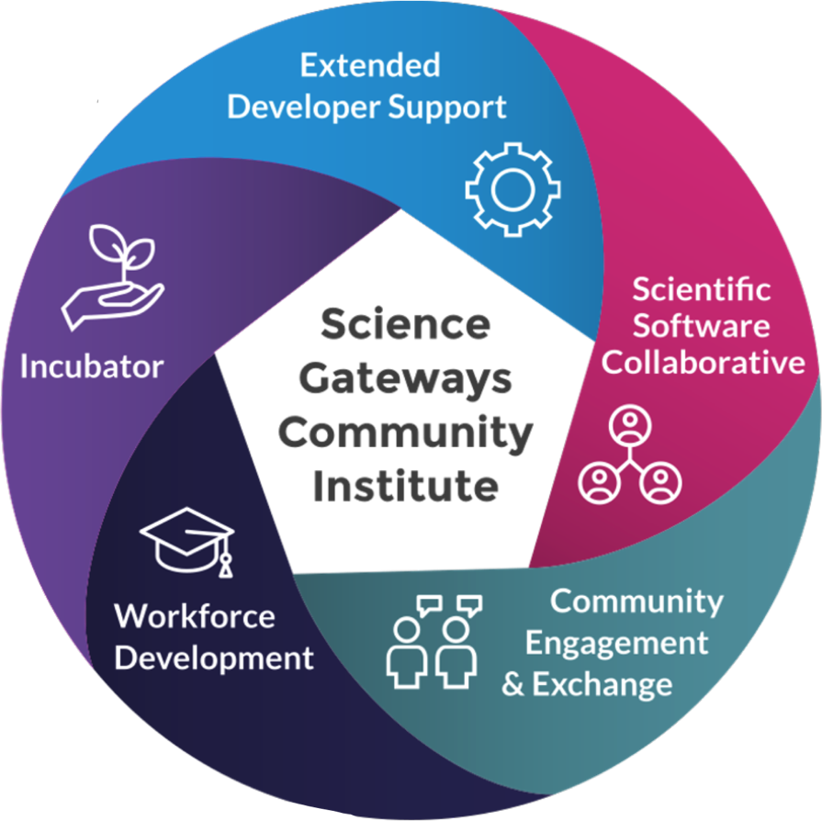

YOU ARE NOT ALONE!
Longer term support engagements
Software and visibility
for gateways
Diverse expertise
on demand
Information exchange
in a community
environment
Student opportunities and
more stable career paths

Slide 16
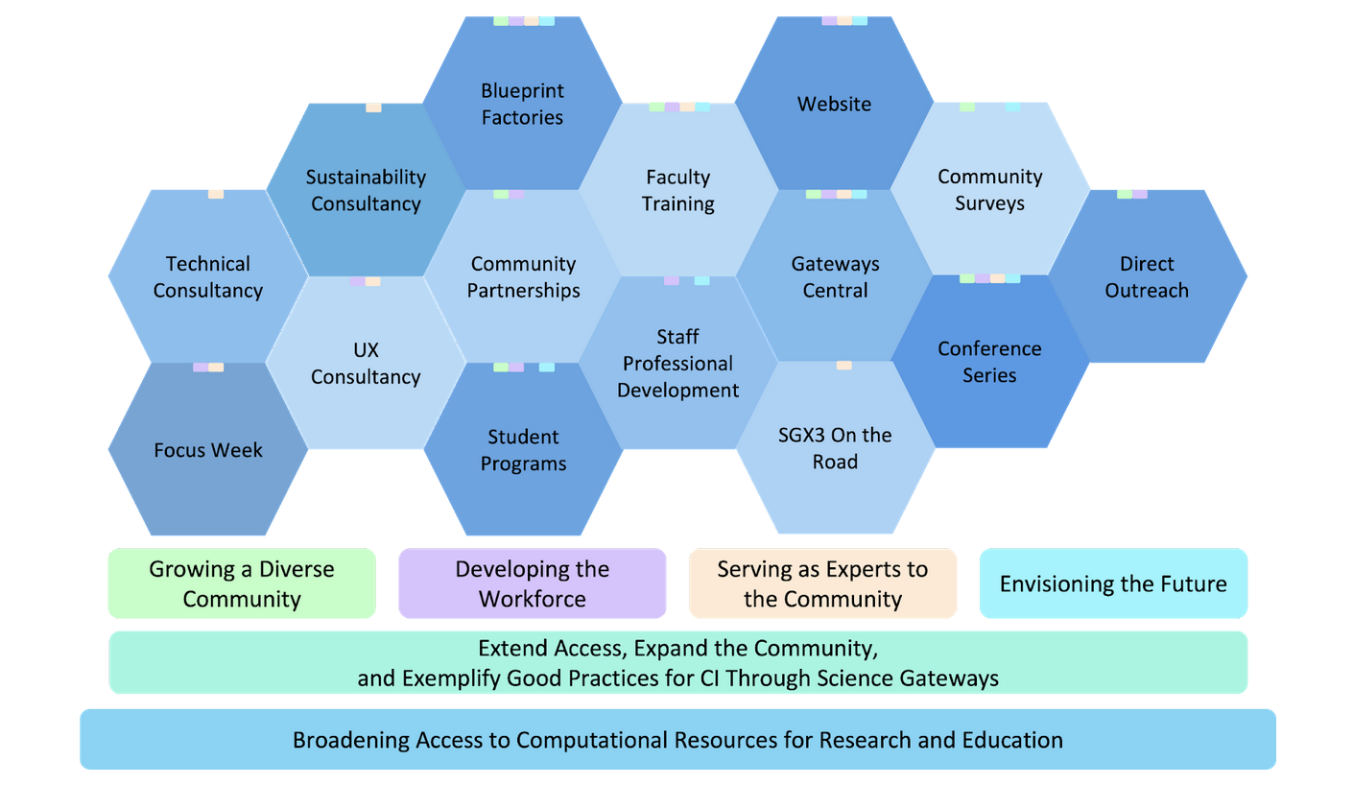
SGX3

Slide 17
SGX3 and SGCI
SGX3 funded
UX evaluation and design engagements lasting up to 3 calendar months
Technology evaluation and gap analysis
Science Gateway architecture design
Summer faculty and student internships
Once annually Science Gateways Focus Week sustainability sessions
Focus Week follow-on sustainability coaching
Summer Coding Institutes
Science Gateway Hackathons
Young Professionals program
Client funded
UX evaluation and design engagements beyond 3 calendar months
Technology selection, expert science gateway software development, and expert science gateway hosting and operations
Academic year intern placement
Specially commissioned Focus Week sustainability sessions
In-depth sustainability assessment and plan development

Slide 18
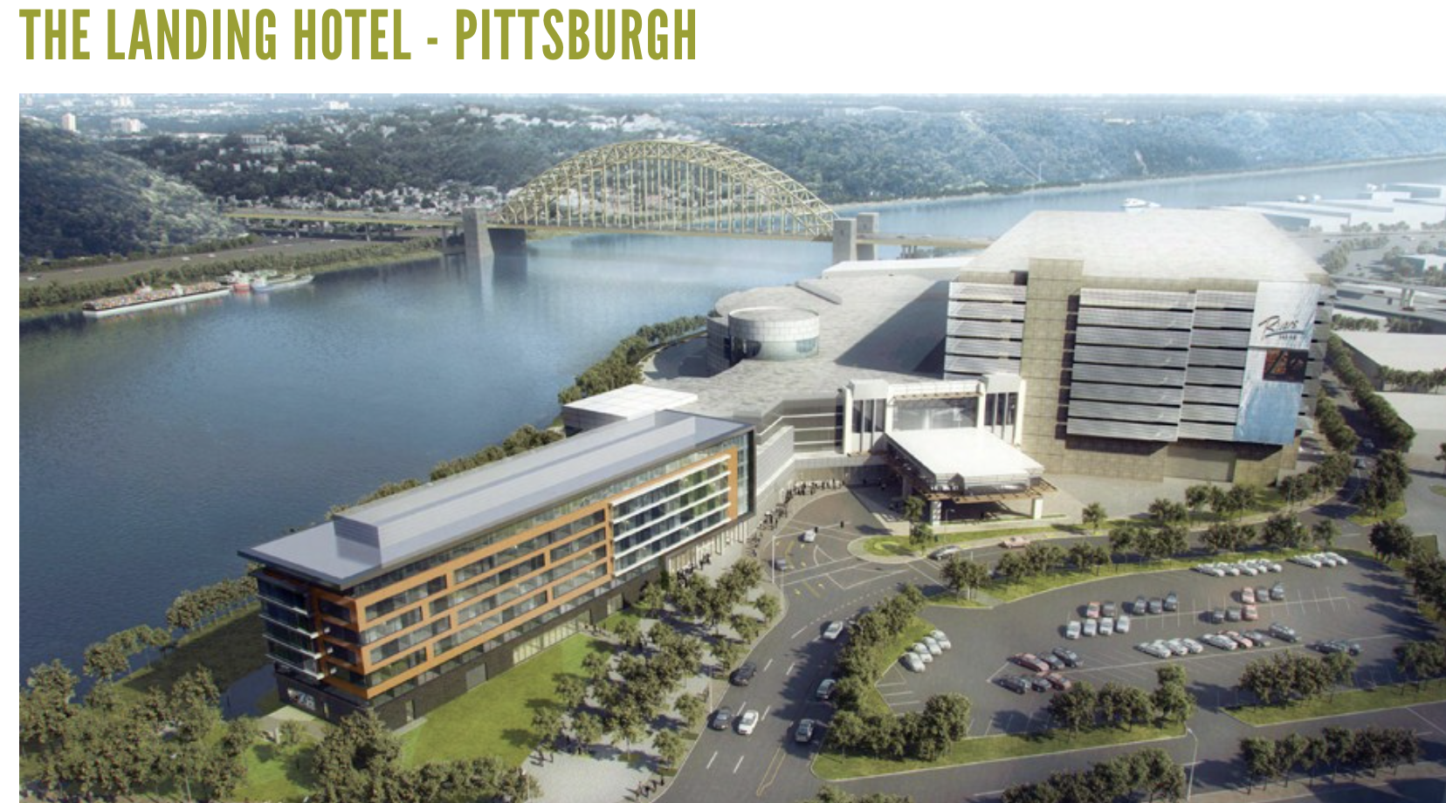
Conference
October 30 – November 1, 2023

Slide 19



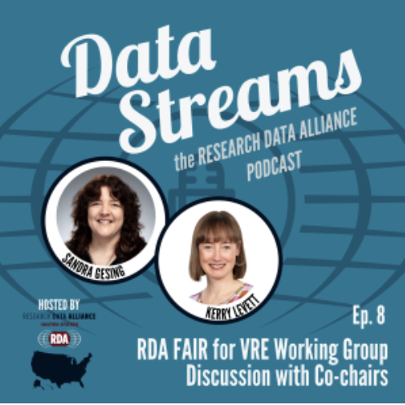

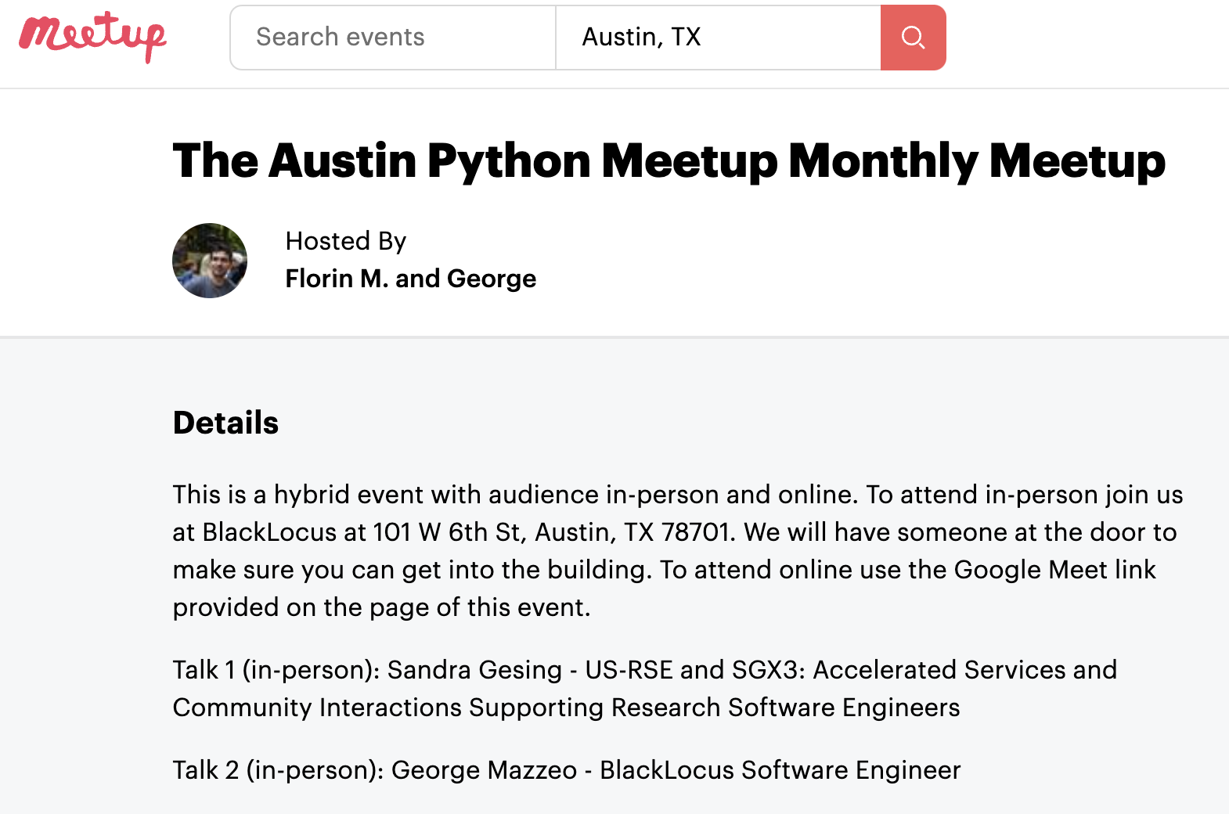
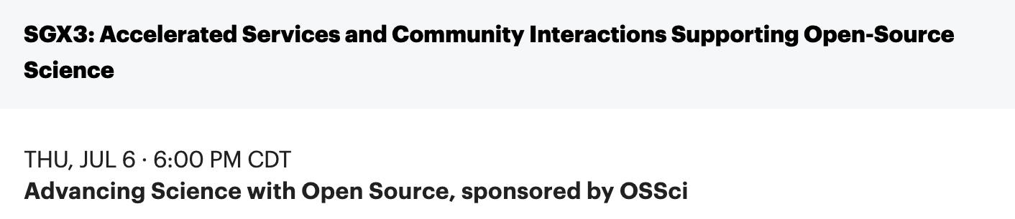
SGX3 On The Road

Slide 20
Sustainability Training
Jumpstart
Are you...
A team member of a recently funded project seeking to financially sustain your work?
An early career professional wanting to learn about sustainable funding solutions?
A research professional working on your next funding proposal?
The Jumpstart Your Sustainability Plan mini-course can help! It's free, and we're offering it virtually.
The next Jumpstart mini-course will be September 12-14, 2023.
APPLY NOW!
https://sciencegateways.org/education-training/sustainability-training

Slide 21
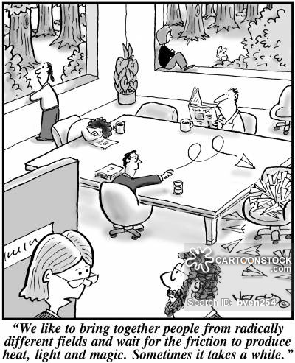
Gateway Ambassadors
Members of a professional community
Community activities
learning from peers
sharing information
Ambassador activities
meeting with individuals
hosting awareness sessions

Slide 22
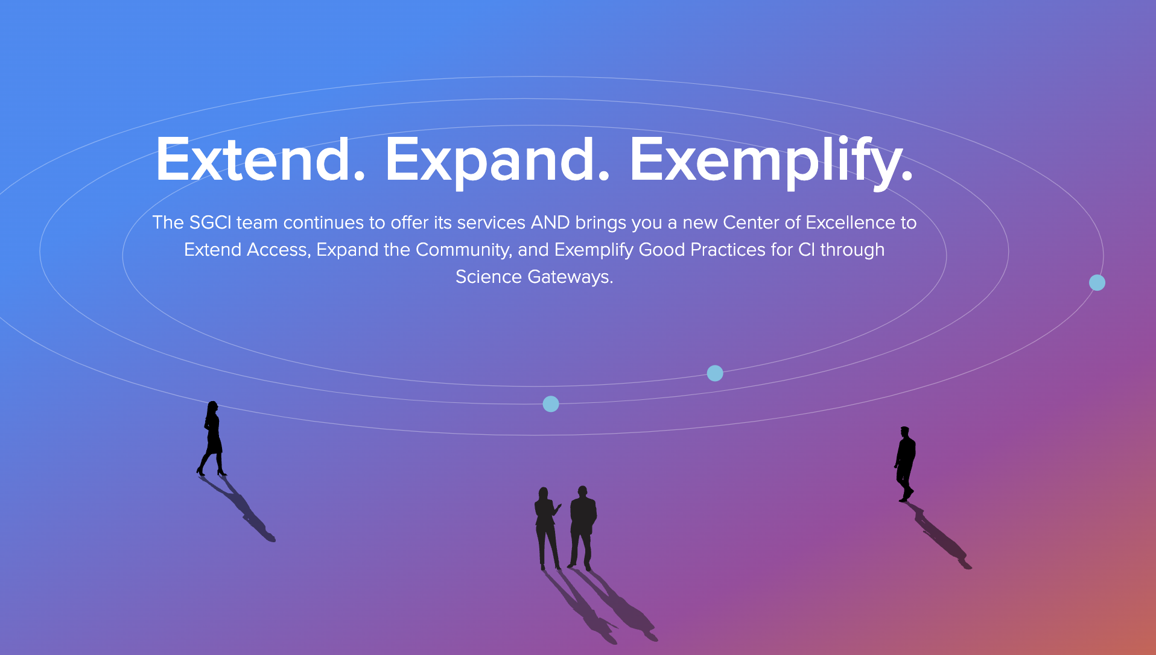
Thank You
Sandra Gesing
sgesing@uillinois.edu
https://sciencegateways.org/

